Slide 1
Integra Overview:
WASM Solver
WASM based
Rust Language
Dual-interface (wasm e nativo)
Request/Response pattern to interface with front-end
Pre-defined JSON messages
Implemented Simulators (Budget, Sparameter, AC, DC, Transient, HB, FTDT)
Netlist parser from JointJS Graph JSON
Factory pattern to manage model of the components
Simulation Orchestration + controller + light calculations
Dataset to put all required data results from the user
webGPUs + shaders for heavy computational algorithm of the solvers
Front-end
Angular
PrimeNg
PrimeBlocks
Apache Echarts
JointJS
Quadtree
JSON
Local Storage
IndexedDB
Back-end
Springboot
Postgres
Buffer IN
Buffer OUT
GPU
Dual-application: web app and desktop app
WebGPU based
WGSL Language
RF Budget Analyzer
Sub-network growth algorithm for S-parameter
Linear Matrix calculation (to be defined)
FFT calculation (to be defined)

Slide 2
Integra GUI:
New
WS + SAVE + UNDO/REDO
Editor
Chart
USER
Find Design
Library
TOO
L
BA
R
Dataset
Apps
Explore
Preferite App #1
Preferite App #N
Designs
Design #1
Design #N
App #1
ZOOMBAR
App #N

Slide 3
General Requirements:
Simulation Locker to avoid running the solver engine more than one time
Absolutely one simulation at the time on the same PC
No simulations on Android

Slide 4
Front-end Requirements:
GUI chatGPT like where
The chats are actually the boards
The apps are actually the GPTs
Charts
Regular chart: already integrated inside
Global chart: a new item in the
Memory optimization
saving netlists and results on indexedDB
One circuit can be plotted at the time and any time it is reloaded from the storage
One chart or group of charts (global charts)

Slide 5
Solver Requirements:
GUI chatGPT like where
The chats are actually the boards
The apps are actually the GPTs
Simulation Locker to avoid running the solver engine more than one time
Absolutely one simulation at the time on the same PC
No simulations on Android
Charts
Regular chart: already integrated inside
Global chart: a new item in the
Memory optimization
saving netlists and results on indexedDB
One circuit can be plotted at the time and any time it is reloaded from the storage
One chart or group of charts (global charts)

Slide 6
Back-end Requirements:
GUI chatGPT like where
The chats are actually the boards
The apps are actually the GPTs
Simulation Locker to avoid running the solver engine more than one time
Absolutely one simulation at the time on the same PC
No simulations on Android
Charts
Regular chart: already integrated inside
Global chart: a new item in the
Memory optimization
saving netlists and results on indexedDB
One circuit can be plotted at the time and any time it is reloaded from the storage
One chart or group of charts (global charts)

Slide 7
Front-end to Solver Communications Requirements:
GUI chatGPT like where
The chats are actually the boards
The apps are actually the GPTs
Simulation Locker to avoid running the solver engine more than one time
Absolutely one simulation at the time on the same PC
No simulations on Android
Charts
Regular chart: already integrated inside
Global chart: a new item in the
Memory optimization
saving netlists and results on indexedDB
One circuit can be plotted at the time and any time it is reloaded from the storage
One chart or group of charts (global charts)

Slide 8
Solver to Front-end Communications Requirements:
GUI chatGPT like where
The chats are actually the boards
The apps are actually the GPTs
Simulation Locker to avoid running the solver engine more than one time
Absolutely one simulation at the time on the same PC
No simulations on Android
Charts
Regular chart: already integrated inside
Global chart: a new item in the
Memory optimization
saving netlists and results on indexedDB
One circuit can be plotted at the time and any time it is reloaded from the storage
One chart or group of charts (global charts)

Slide 9
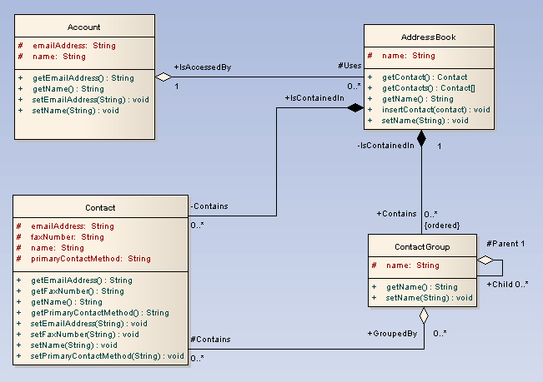
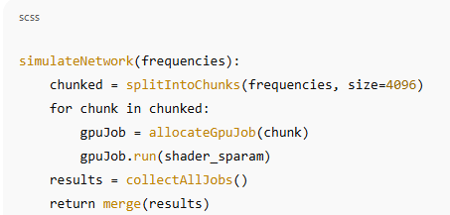
Module #1:
Overview:
Constraints:

